Slide 1
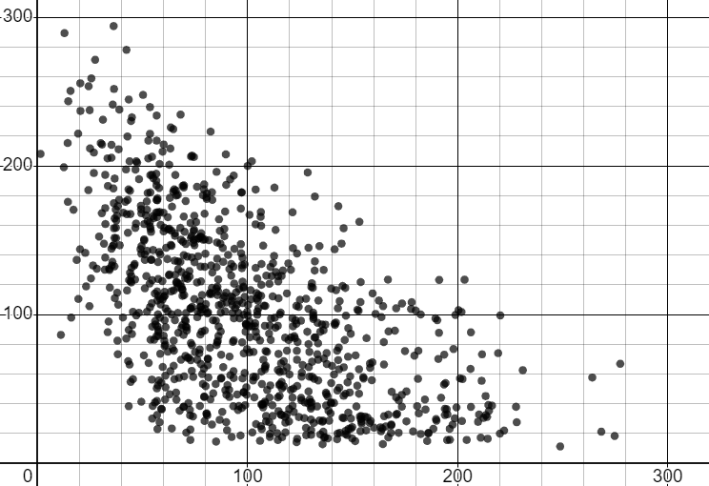
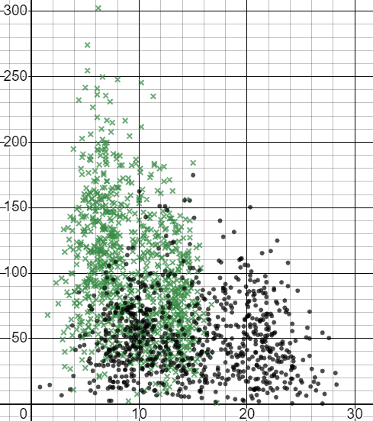
Interpreting scatter graphs
Task A: Observing trends in scatter graphs
1) The scatter graph shows data from the Met Office about the weather in Stornoway for each month from 1941 to 2022.
Write ‘true’ or ‘false’ for each statement below, based on the scatter graph.
a) Months with more rain tended to have less sunshine.
b) Months with more sunshine tended to have less rain.
c) Some months recorded no sunshine.
d) All of the months that had more than 150 mm of rain also had less than 200 hours of sunshine.
True
True
total sunshine duration (hours)
False
True
total rainfall (mm)
2) The scatter graph shows data from the Met Office about the weather in two towns for each month from 1941 to 2022.
Heathrow
Lerwick
a) Which town tends to get more rainfall?
Lerwick
b) Which town tends to get warmer?
Heathrow
c) A new data point records 5℃ and 100 mm. Which town is it more likely to be?
total rainfall (mm)
Lerwick
d) A new data point records 20℃ and 100 mm. Which town is it more likely to be?
Heathrow
mean of daily maximum temperature (℃)

Slide 2
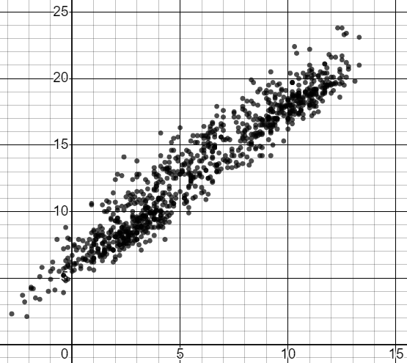
Interpreting scatter graphs
Task B: Using trends and interpolation to make predictions
The scatter graph shows data from the Met Office about the weather in Armargh for each month from 1941 to 2022.
mean of daily maximum temperature (℃)
mean of daily minimum temperature (℃)
Given the following minimum daily temperatures, estimate the range of maximum daily temperatures.
a) minimum: 10℃ maximum: between and ℃
16
20
b) minimum: 5℃ maximum: between and ℃
10
15
c) minimum: 0℃ maximum: between and ℃
5
8
Mathematics in Education and Industry
v2.2

